Slide 1
Morris County AARP Tax-Aide
TaxWise Familiarization
Notes:
Recommended forms to be handed out:
Intake Sheet – 2010 form available on line at IRS.GOV
IRS Form 1040 - 2010 form available on line at IRS.GOV
Schedule A -2010 form available on line at IRS.GOV

Slide 2
Morris County AARP
Tax-Aide Program
Welcome to the Class of
Tax Year 2015

Slide 3
Inspiration

Slide 4
Goal
Familiarize students with TaxWise Software prior to Integrated Tax Law/ TaxWise Training
  Open TaxWise Online using user ID and password
  Navigate through the software
  Start a return
  Complete main information sheet
  Enter most common income types
  Enter data for certain credits
  Transition of information from federal to NJ
  Complete Federal & NJ return

Slide 5
Agenda Day 1
(Monday, October 26, 2015)
  Welcome
  Program overview (Nancy Niemann)
  Orientation (Nancy Niemann)
  Introductions
  Online training (Al Hershey)
  Demo of online training resources (Al Hershey)
  Introduction to tax forms
  Cheat sheet
  Log in to TaxWise Online (TWO)
  Overview of TaxWise Online (TWO)
  Complete a return together

Slide 6
Walk In Workshops
Voluntary
One on one help
10/30 Fri 9:00-12:00 Parsippany Library A
11/06 Fri 9:00-1:00 Parsippany Library A
Let me know via email if you are planning to attend

Slide 7
Agenda Day 2
(Monday, November 2, 2015)
Answer questions
Review problems as necessary
What’s next?
  Review calendar
  Integrated tax law/TaxWise Training
  Proficiency Part 1 (4 problems 2014 Tax Law)
  Proficiency Part 2 – (IRS certification test 2015 Tax Law)
  Proficiency Part 3 – (1 or2 additional problems 2015 Tax Law – Focus on 2015 changes)

Slide 8
Overview of Tax-Aide Program by
Nancy Niemann – District Coordinator
General orientation
Who we are
Insurance coverage
Standards of Conduct Agreement
Site orientation
Reimbursement
Training philosophy

Slide 9
Orientation
Rest Rooms
Lunch
Name Tags – First Name and Initial Only Required in Sites
Put Your Names on Your Training Material
Sign-in List
Roster – Check off that information is correct
Notes:
Customize for you facility.

Slide 10
Who We Are
Charitable, non-profit program administered by AARP Foundation
Free, Nationwide, Confidential service
Help low-to-mid income taxpayers with special attention to age 60+ (VITA/TCE)
Committed to high-quality service
Answer tax questions/prepare returns
Funded 1/3 AARP; 2/3 IRS TCE

Slide 11
Insurance Coverage
Travel accident insurance coverage if on Tax-Aide business
  Supplemental secondary only for you, not your automobile
  Notify District Coordinator ASAP
Personal Liability
Code of Conduct Agreement
10/25/2015
NJ Integrated Training - 2007 Tax Season
11
Notes:
11
All tax information you receive from taxpayers in your Volunteer capacity is strictly confidential and should not, under any circumstances, be disclosed to unauthorized individuals.
All volunteers involved in the Volunteer Tax Preparation program must adhere to the guidelines that are stated in Publication 678, Page 5, Confidentiality And Integrity.
All tax information you receive from taxpayers in your Volunteer capacity is strictly confidential and should not, under any circumstances, be disclosed to unauthorized individuals.
All volunteers involved in the Volunteer Tax Preparation program must adhere to the guidelines that are stated in Publication 678, Page 5, Confidentiality and Integrity.

Slide 12
Site Orientation
Site organization (who does what)
  SC -- Site Coordinator
  CF -- Client Facilitator
  EFC -- Counselor
  QR -- Quality Reviewer
  ERO – Electronic Return Originator
Working with the client
Site Preference Forms

Slide 13
Miscellaneous
Reimbursement – Document dates and Locations
Training Philosophy
  Don’t memorize – use resource mat’l
  Test is part of the learning process
  Don’t do Military and International
  Don’t let training drive you crazy
  Remember that the fun part is fast approaching

Slide 14
Tell Us About Yourself
Name
Home town
Occupation
  Current or pre-retirement
Computer experience
  Computer Geek to I just do E-mail
Tax experience
  Tax CPA to I never did a tax return
Why did you volunteer?
What are your expectations of the AARP Tax-Aide Program

Slide 15
Online Training
TaxPrep4Free.org web site
  Developed by Al Hershey
  Used to supplement class instruction
  Flip Teaching – Watch the lecture before class and use class time for book work, interaction, quiz questions, and preparing the Kent return.

Slide 16
TaxPrep4Free Demo
Al will do Demo

Slide 17
Forms
IRS Intake & Interview Form
IRS Form 1040 and NJ 1040
Notes:
Go to TaxPrep4Free power points.

Slide 18
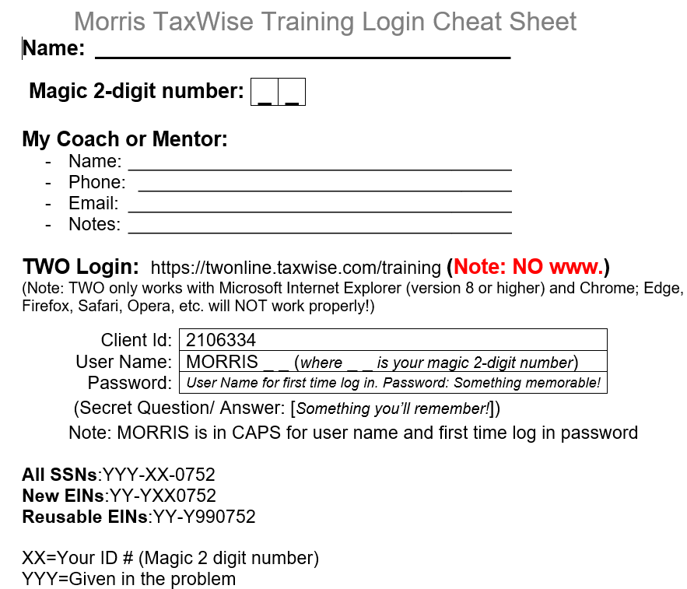
The Cheat Sheet

Slide 19
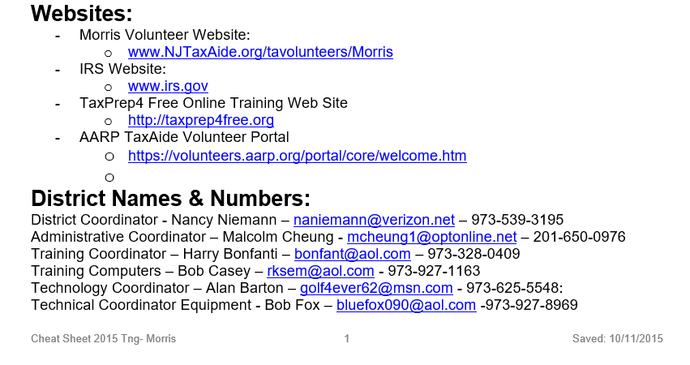
The Cheat Sheet Continued

Slide 20
TaxWise Demo & Problem
Do TaxWise Demo & Problem

Slide 21
TaxWise Online - TWO
First Log-In
Set Desktop shortcut
Set IE shortcut
Set CAP Lock
Overview of home page
How to get problem
Problem Set Up
Review refund monitor
Brown Return

Slide 22
To Do Between Now and Class 2
Complete Familiarization Checklist Items
Complete the 8 Familiarization Problems located on TaxPrep4Free.org web site. Enter into TaxWise and have Coach review.

Slide 23
Caution
Anything you enter in TWO can be viewed by instructors and coaches

Slide 24
Thank you for Volunteering

